Slide 1
Project 4: Data Visualization in Tableau
By: Jack Sechler
jsechh@gmail.com

Slide 2
Udacity Business Analytics - Data Visualization in Tableau
In this project, you'll create visualizations to reveal insights from a data set. You will create data visualizations that tell a story or highlight patterns in the data set. Your work should be a reflection of the theory and practice of data visualization, such as visual encodings, design principles, and effective communication.

Slide 3
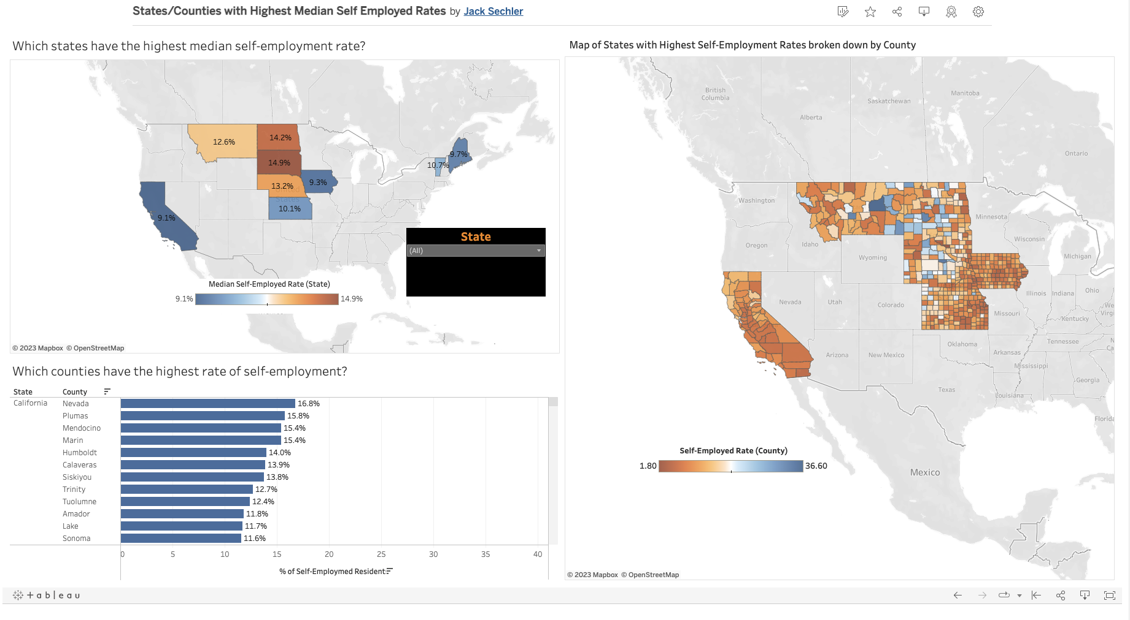
1.
TRANSITION HEADLINE
Let’s start with the first set of slides

Slide 4
Which states have the highest median Self employment rate?
From this dashboard we can see the top 10 states where the median self-employment rate is the highest. I chose to use a blue-orange gradient on the maps so to be easy for all readers to view. The darker blue represents the lowest of the 10 states in terms of median self-employment rate while colors that move towards orange represent those with higher median self-employment rates. The drop-down menu allows the user to pick a state and see which counties have the highest percentage of self-employed residents. From the map, it is clear that South Dakota has the highest median self-employed rate coming in at 14.9%. Next is North Dakota (14.2%) and Nebraska (13.2%). To do this, I found the states with the highest median income and grouped them. I used this group to filter down to the specific states I wanted to include. I chose to include only relevant values to prevent any issues coming up with the non-grouped states.
Given that we’re working with State/County/Geographical data, I felt that the best way to represent this was through a few maps and a bar chart to show the distribution across the respective counties. Although the map representation of the specific counties was not necessary here, I chose to include it because I really liked how it geographically broke down each state by its bits and pieces, and I thought the reader would too.
Link: Tableau Dashboard 1

Slide 5
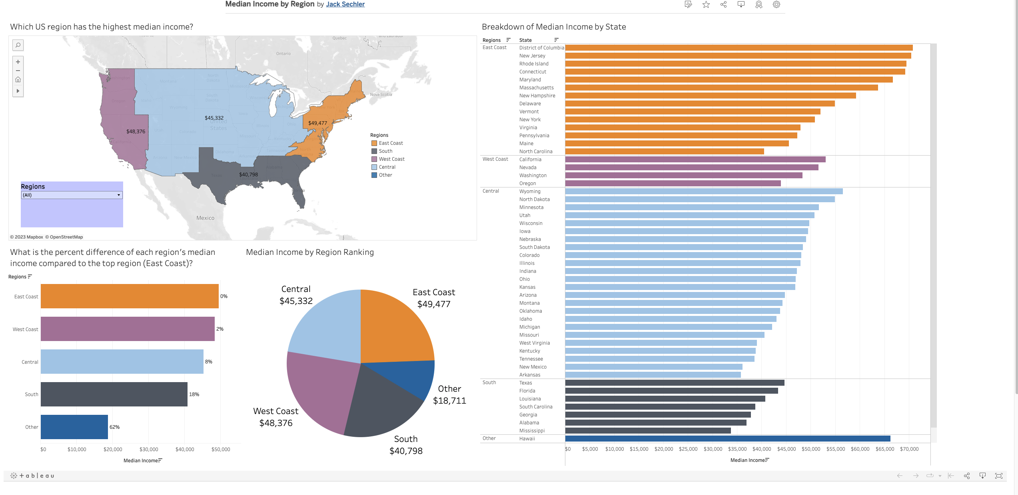

Slide 6
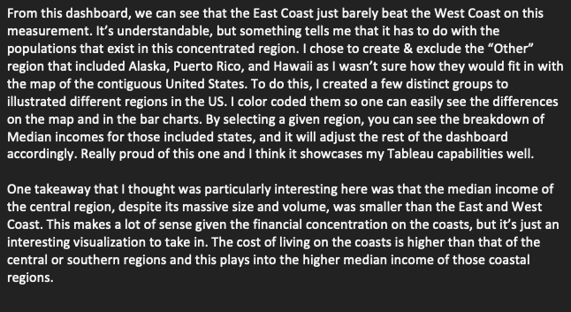
Which US region has the highest median income?
Link: Tableau Dashboard 2

Slide 7
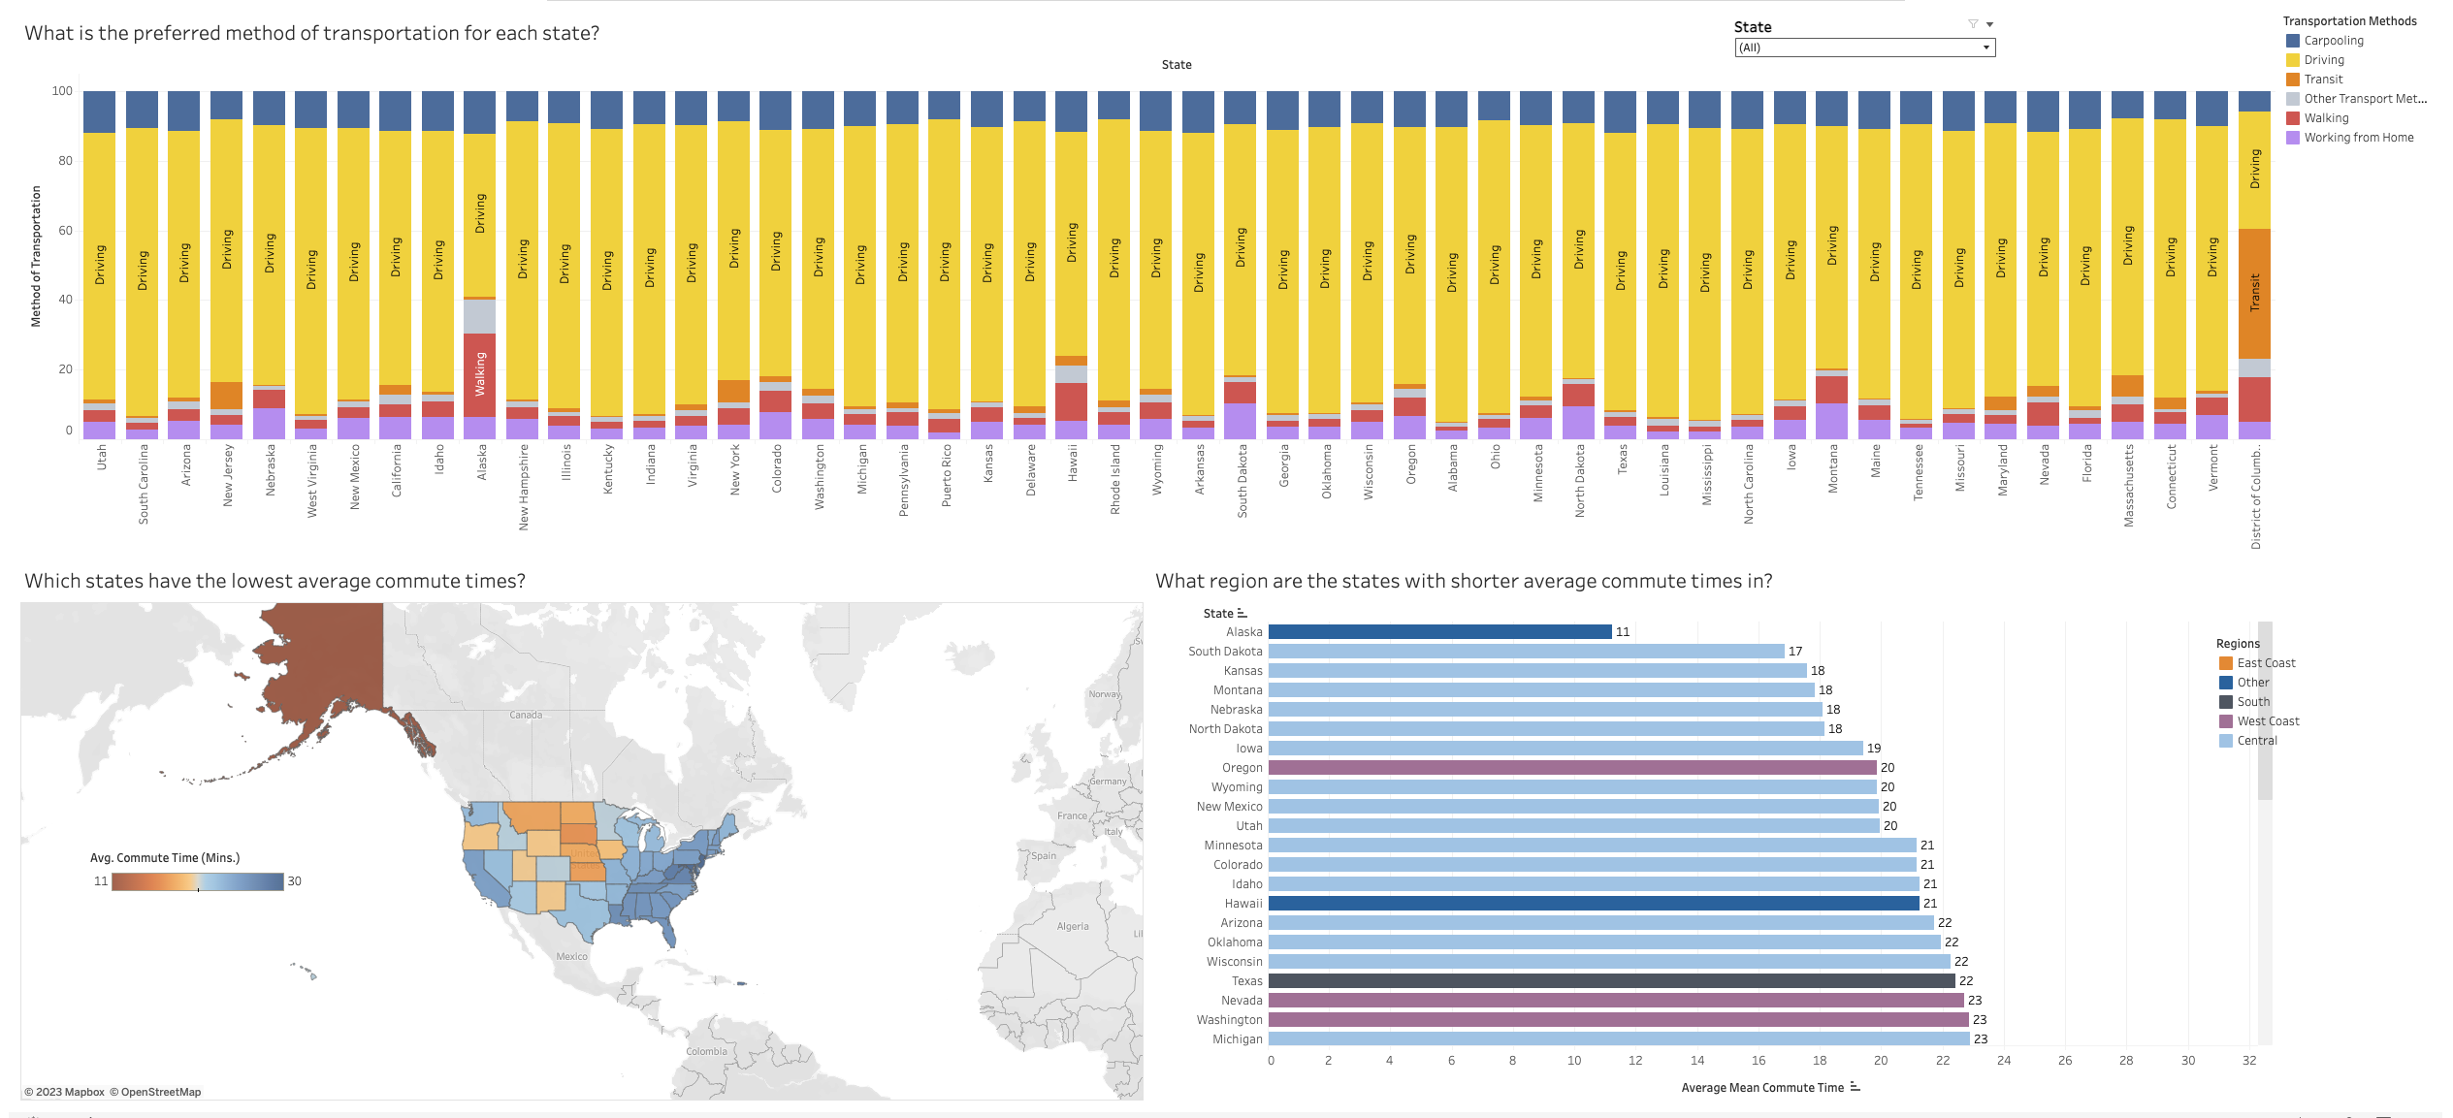
Udacity Business Analytics - Data Visualization in Tableau
In this project, you'll create visualizations to reveal insights from a data set. You will create data visualizations that tell a story or highlight patterns in the data set. Your work should be a reflection of the theory and practice of data visualization, such as visual encodings, design principles, and effective communication.

Slide 8
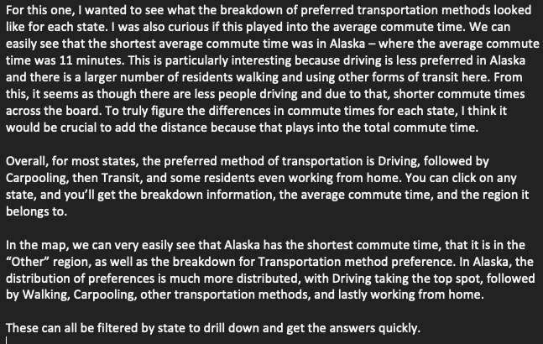
What is the preferred method of transportation?
Link: Tableau Dashboard 3

